Slide 1

GoGreen
The travel planner that makes the world better.

Slide 2
29,7%
of Carbon Dioxide comes from transportation in Helsinki Metropolitan Area.
Notes:
Total of 4.8 million tonnes of greenhouse gas emissions in 2018.

Slide 3





Slide 4



No way of visualizing
Poor awareness
Lack of personal responsability

Slide 5
How can we facilitate for citizens to make sustainable choices in their everyday transportation ?
Notes:
Our solution is travel app that helps Finnish passengers to make most sustainable everyday transport choices.

Slide 6

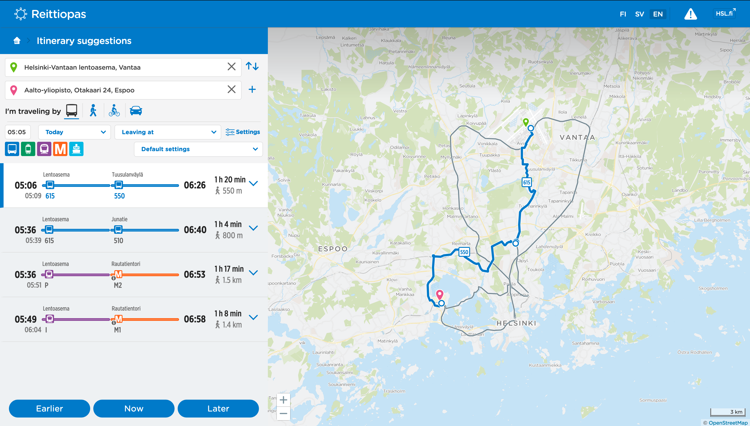


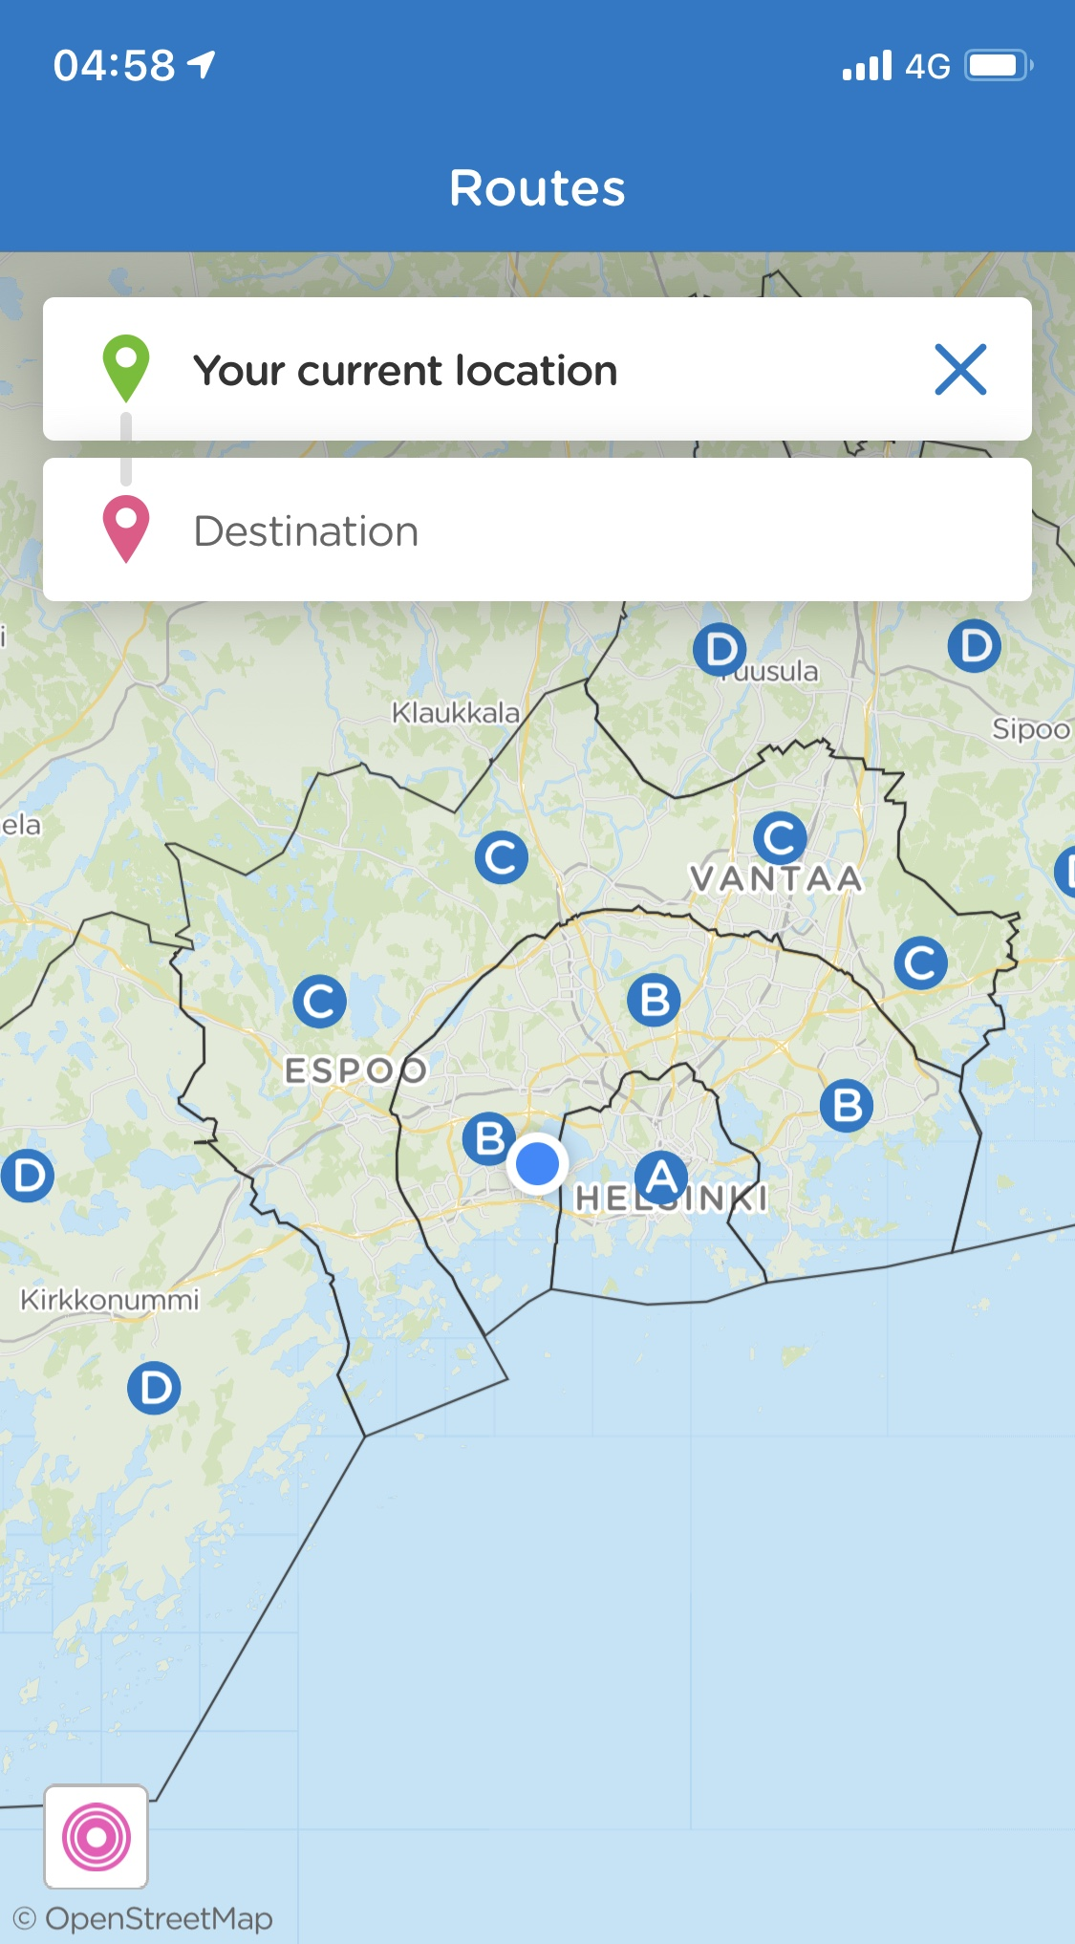
GoGreen
Transport | Duration | Distance | CO2
Bike | 22 min | 4.2 km | 0 kg
Metro | 8 min | 5.7 km | 1.4 kg
Bus | 16 min | 7.3 km | 5.2 kg
Car | 11 min | 4.5 km | 4.3 kg
Simple
Smart
Eco-responsible

Slide 7



Open Data API
Accurate computations
Notes:
Is it that simple ? What did you guys do during 2 days ?
That’s not all, and to illustrate an additional feature of our app let’s run the demo.

Slide 8
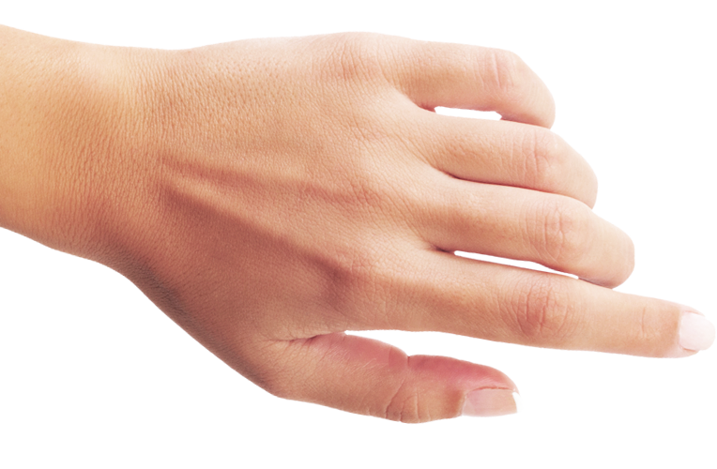
Wait ! My predictions are telling me that this bus station will be hardly crowded at this time, wouldn't be bike a more peaceful transportation ?
Transport | Duration | Distance | CO2
Bike | 22 min | 4.2 km | 0 kg
Metro | 8 min | 5.7 km | 1.4 kg
Bus | 16 min | 7.3 km | 5.2 kg
Car | 11 min | 4.5 km | 4.3 kg
Yes, go with bike!
No, bus…

Slide 9
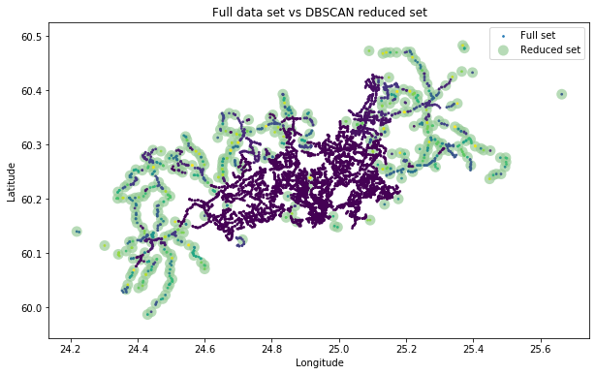






Open Dataset
Machine Learning
[https://www.avoindata.fi/data/en_GB/dataset/hsl-n-nousijamaarat-pysakeittain]

Slide 10

« Our solution is a way of educating people in order to reduce their carbon footprint. »
Notes:
Reduction of carbon emission
Increasing public awareness
Educating people

Slide 11



So, what’s next ?
Sustainable City Places
Everyday Tips
Gamification

Slide 12
GoGreen
The travel planner that makes the world better.

Slide 13



Architecture
Our server
Users
HSL Database
Prediction of crowdedness

